Slide 1


AI - Powered Career Guidance and Resume Screening
Author:
Kshama Jain
Aanchal Pathak
Priyanshi Prajapati

Slide 2

CONTENTS
1. Introduction
2. Problem Statement
3. Solution
4. Objectives
5. Technology Used
6. Implementation Details
7. Results & Analysis
8. Conclusion
9. Future Enhancements
10. Research & References

Slide 3

1. Introduction
Career choice is a crucial decision for every student, yet many struggle due to limited guidance and awareness. The Career Guidance Tool aims to provide personalized career recommendations using Artificial Intelligence (AI) and Natural Language Processing (NLP). By analyzing a student’s resume, skills, and interests, the system suggests the most suitable career paths and job roles. The main objective is to bridge the gap between education and employability, empowering students to make informed career decisions.

Slide 4



2. Problem Statement
Issues Faced by Students and Graduates
Students and fresh graduates struggle to know which role suits them: Most students are unaware of their strengths or weaknesses in terms of professional skills.
Recruiters spend time manually screening resumes: HR teams often receive hundreds of resumes, and manual screening is time-consuming and inconsistent.
Lack of personalized skill improvement guidance: Candidates do not know which skills they need to improve to fit their desired roles.

Slide 5





3. Solution
The proposed solution is an AI-powered Career Guidance Tool that:
1
2
3
4
Analyzes resumes (PDF/DOCX) and extracts candidate information.
Suggests the most suitable job role based on skills.
Provides personalized tips to improve skills.
Displays a results table for easy HR review.

Slide 6


4. Objectives
Automate the resume evaluation process.
Recommend the most suitable job role for each candidate.
Provide actionable tips for skill improvement.
Reduce HR workload and increase recruitment efficiency.

Slide 7





5. Technology Used
Layers Tools/Frameworks
1
2
Frontend
Resume Extraction
Streamlit
PyPDF2, docx2txt
3
4
NLP
ML
NLTK
Scikit-learn (TF-IDF, Cosine Similarity)
5
6
Data Handling
Programming
Pandas
Python

Slide 8




6. Implementation Details
Resume Upload
Text Extraction
Supports PDF and DOCX files.
• PDF: PyPDF2
• DOCX: docx2txt
Text Preprocessing
Skill Matching
Lowercase conversion, punctuation removal, tokenization, stopword removal (NLTK).
Predefined job roles with required skills using TF-IDF vectorization + Cosine similarity for ranking.
Perfect Match Logic
Tips Generation
Checks if all required skills exist in the resume. If yes, it shows: ✅ “Your skills perfectly match this role. No improvement needed!”
Only shown if skills are incomplete.

Slide 9


7. Results & Analysis
Sample Output Table
Analysis
• High suitability score → candidate is ready for the role.
• Low score → candidate needs to improve specific skills.

Slide 10
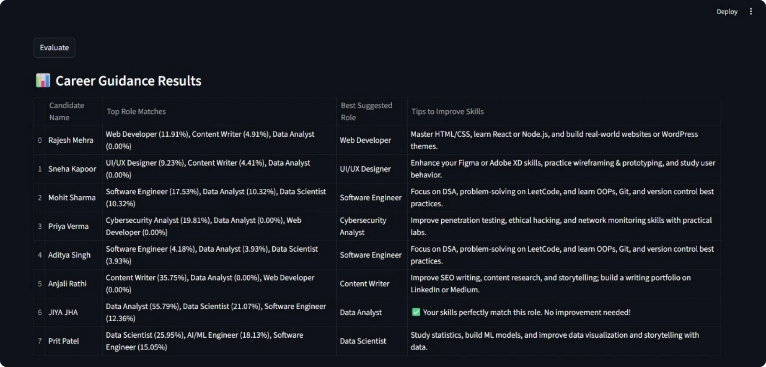

Slide 11
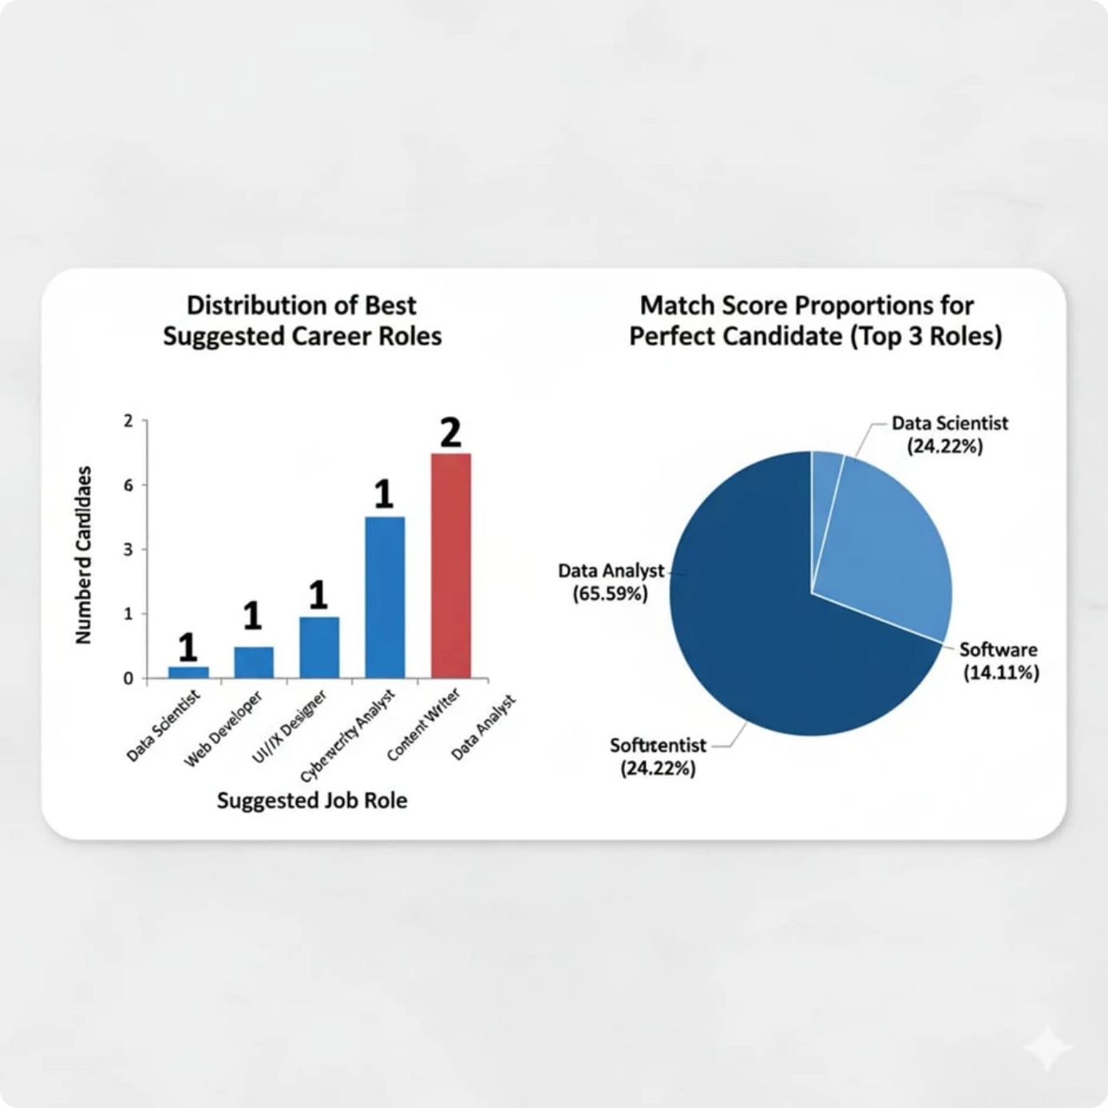
The system successfully mapped candidates to 7 high-demand roles and provided actionable, personalized skill roadmaps. The dominant Data Analyst match (65.59%) for the highest-scoring profile validates the system's accuracy and value.
Software Engineer is the most frequently suggested "Best Suggested Role" (suggested for Mohit Sharma and Aditya Singh).
The "Perfect Candidate" has an exceptionally high match score for Data Analysis (65.59%), with the tool noting: "Your skills perfectly match this role. No improvement needed!"
The results show a mix of roles across Data Science, Web/Software Development, UI/UX Design, Cybersecurity, and Content Writing.

Slide 12



8. Conclusion
The Career Guidance Tool helps students discover suitable roles.
HR benefits from automated resume screening, reducing time and bias.
Personalized tips provide candidates a roadmap to improve skills.
The tool can be extended with:
• Job description matching.
• Multi-role suggestion.
• Graphical dashboards for multiple candidates.

Slide 13




9. Future Enhancements
1
Integrate job description input to match resumes with specific openings.
2
Add skill gap visualization (missing vs. required skills).
3
Include downloadable reports for HR.
4
Expand the tool to industry-specific skill sets.

Slide 14



10. Research & References
NLTK documentation: https://www.nltk.org/
Scikit-learn TF-IDF & Cosine Similarity: https://scikit-learn.org/stable/modules/feature_extraction.html
Streamlit Documentation: https://docs.streamlit.io/
IEEE Conference on AI-based Resume Screening & Job Matching, 2020
International Journal of Computer Applications: AI in Career Guidance, 2021

Slide 15

Thank You

